Slide 1


Slide 2

ELEMENTARY OS
19CSE213 OS PROJECT
Team Number-
B.TECH/ II YEAR/ IV SEMESTER
OPERATING SYSTEM
ROLL NUMBER | NAME
CB.EN.U4CSE20068 | HARSHITH THATAVARTHI
CB.EN.U4CSE20020 | GADDE ASHOK
CB.EN.U4CSE20037 | M DUSHYANTH REDDY
CB.EN.U4CSE20027 | D JAI PRAKASH
Elementary OS

Slide 3
Table Of Contents
Introduction
Installation (DUAL BOOT)
Features
System Calls
File System Calls
Directory System Calls
Process System Calls
Scheduling algorithms
Elementary OS

Slide 4
introduction
Elementary OS

Slide 5

INTRODUCTION
Free and open-source Linux distribution based on the Ubuntu operating system that has a focus on user-friendliness and accessibility.
The operating system, the desktop environment and accompanying applications are developed and maintained by Elementary INc.,
Consists of pre-installed applications for the user’s convenience.
Developed by Elementary Inc., and this company rapidly works to give continuous updates to all users. Distinct from other OS as it provides full control over hardware.
Elementary OS

Slide 6
INTRODUCTION
It is a modern, fast and open source competitor to Windows and macOS. It's been designed with non-technical users in mind and is a great introduction to the world of Linux, but also caters to veteran Linux users.
Elementary OS focuses on enhancing visuals and minimizing performance issues; so if you generally opt for better design over better performance, you should go for Elementary OS.
Elementary OS offers easily boasts one of the most consistent UI among Linux distros. Everything that you use in elementary OS is custom-built and best suited to provide a conveniently consistent UI. Of course, you are free to install other apps and app types of your choice.
Elementary OS

Slide 7
INSTALLATION
DUAL BOOT METHOD
Elementary OS

Slide 8
SYSTEM REQUIREMENTS
Intel i3 or higher dual core 64-bit processor wirh 4 GB of RAM or higher.
Solid State Drive (SSD) or Hard Disk Drive (HDD) with atleast 32 GB of free space.
Built in or wired mouse/ touchpad and keyboard, internet connection if needed and 1024 x 768 resolution.
Elementary OS

Slide 9
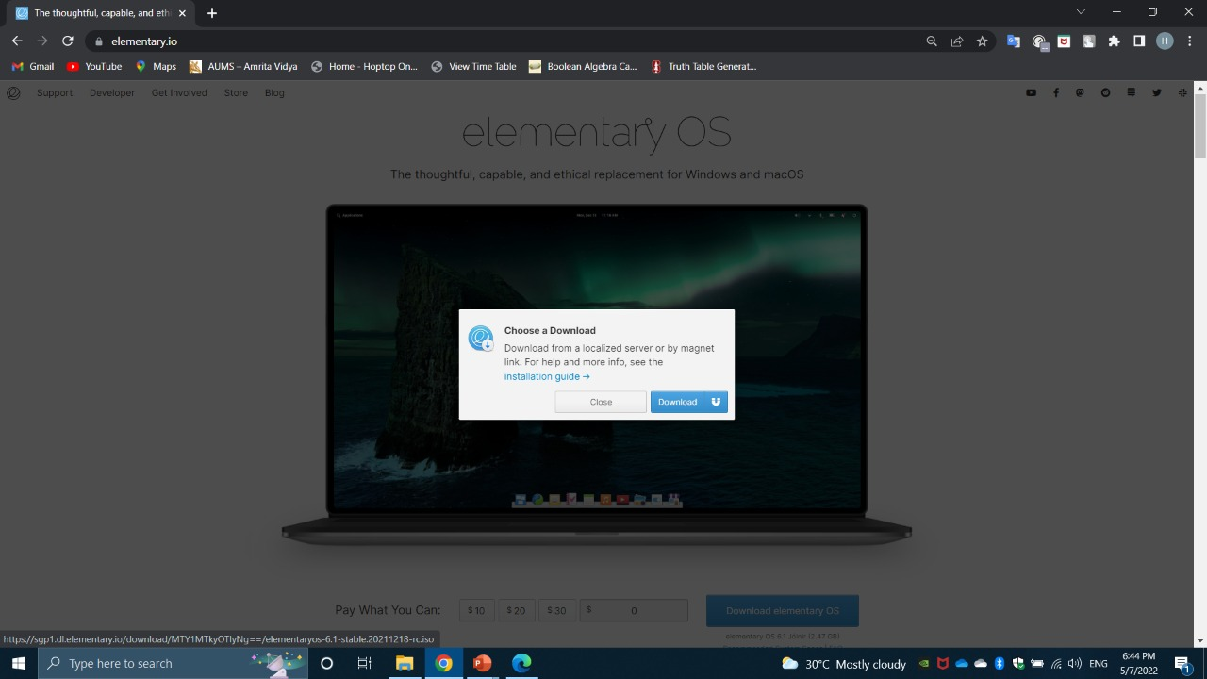
INSTALLATION
Download the iso file from website elementary.io
Elementary OS

Slide 10
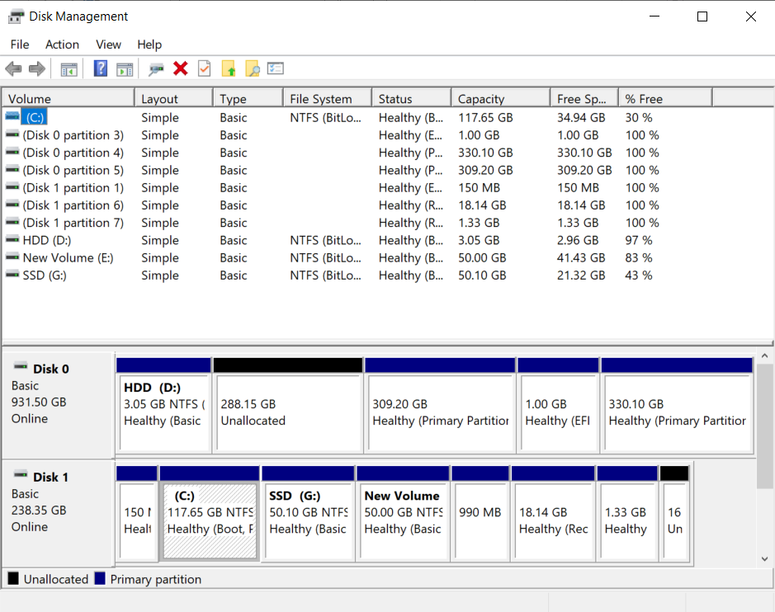
INSTALLATION
Now allocate some space for installing elementary OS.
This can be done by clearing space and deleting a partition so that it gets unallocated as shown.
Elementary OS

Slide 11
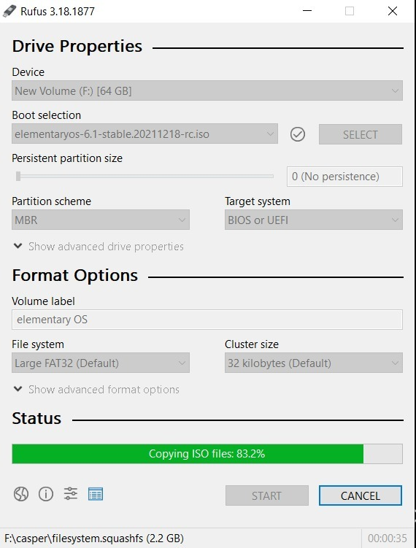
INSTALLATION
Download rufus 3.18 from website rufus.ie
Insert a pendrive of atleast 4GB in size.
Select the pendrive so that the iso file which we downloaded previously will be burned into pendrive.
Select iso file in rufus.
Click on start, then it will burn iso file into pendrive.
Elementary OS

Slide 12
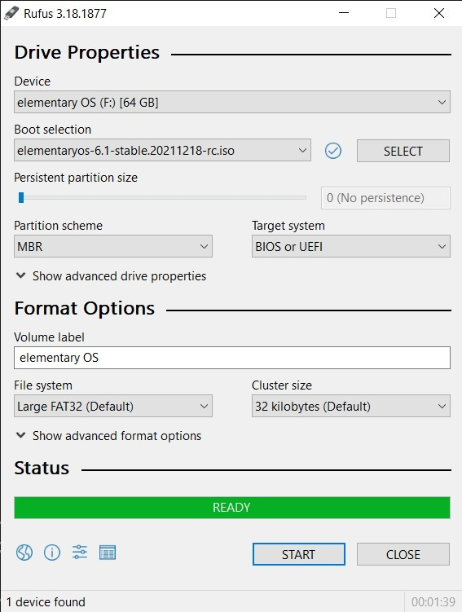
INSTALLATION
Once the burning is done, rufus will show that pendrive is ready.
Now we will reboot the PC and enter the BIOS boot menu.
Elementary OS

Slide 13
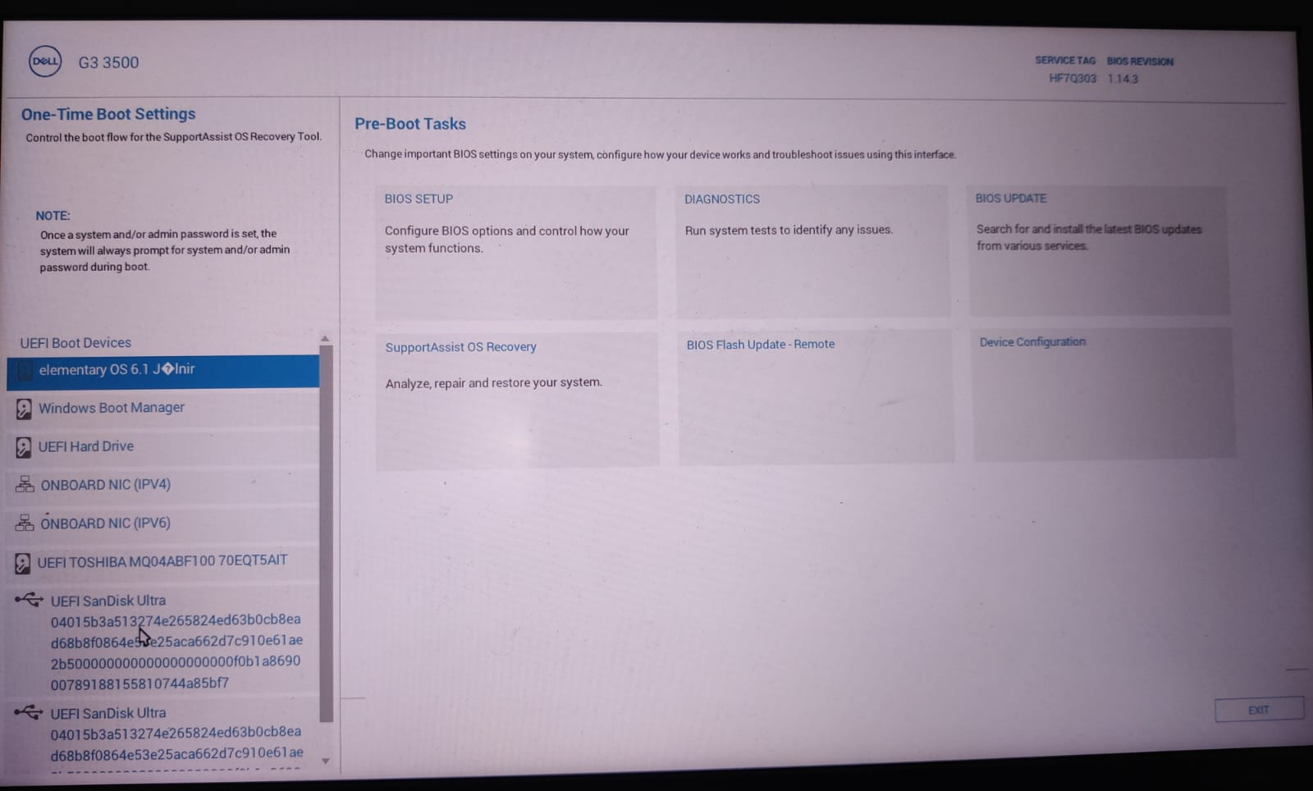
INSTALLATION
Press F12 to enter one-time boot menu.
Now select UEFI SanDisk Ultra from the list.
Elementary OS

Slide 14
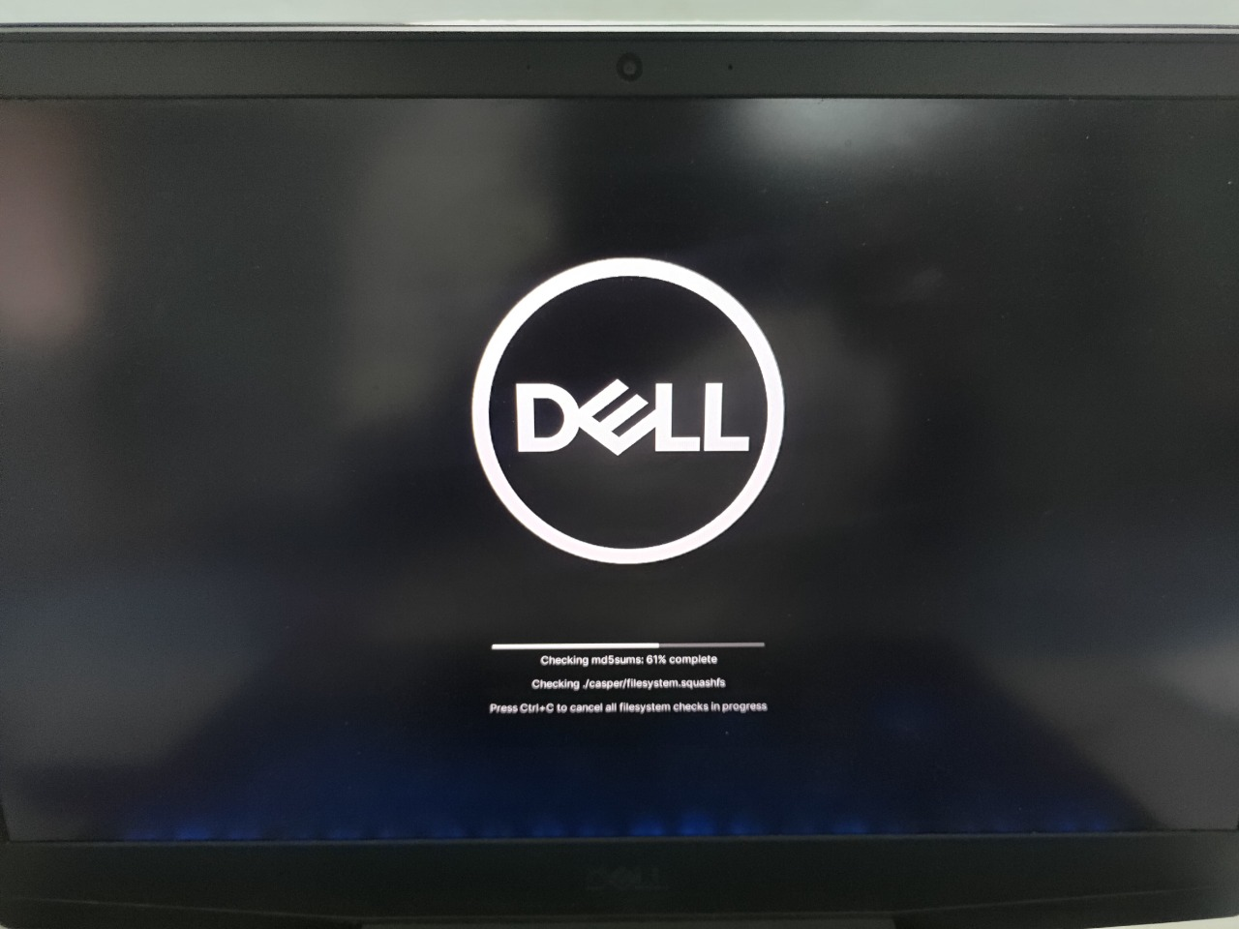
INSTALLATION
After booting via USB, the elementary OS will first check the integrity and checksum errors in iso file.
Then it will proceed to next step.
Elementary OS

Slide 15
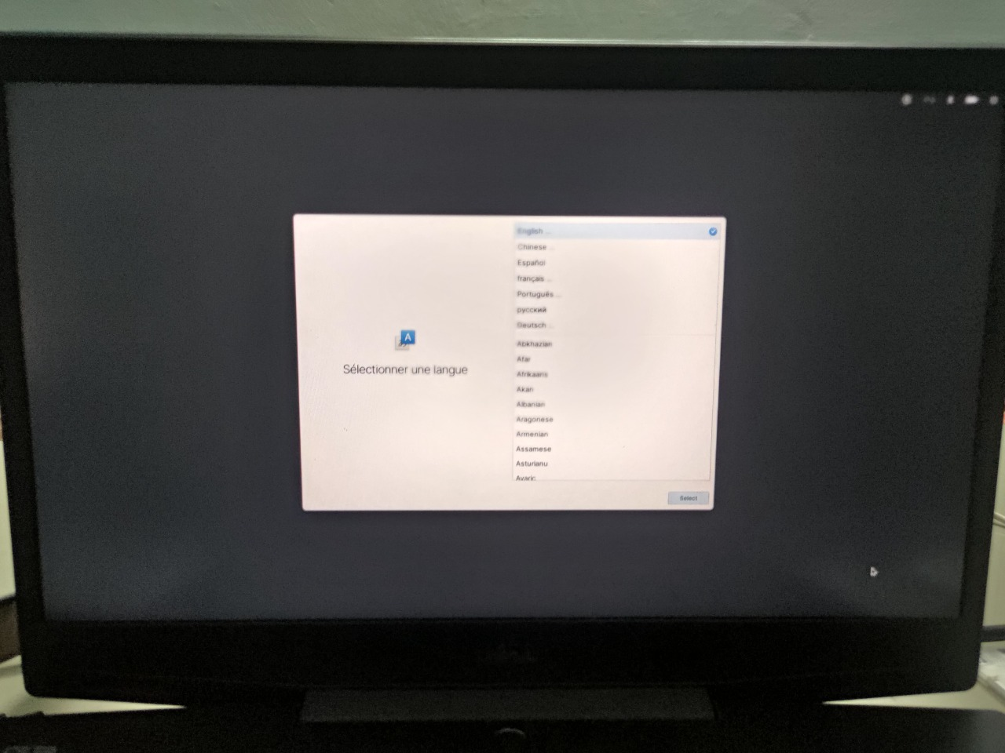
INSTALLATION
Now we have to select the default language for the system.
Then we have to select the default keyboard layout.
Elementary OS

Slide 16
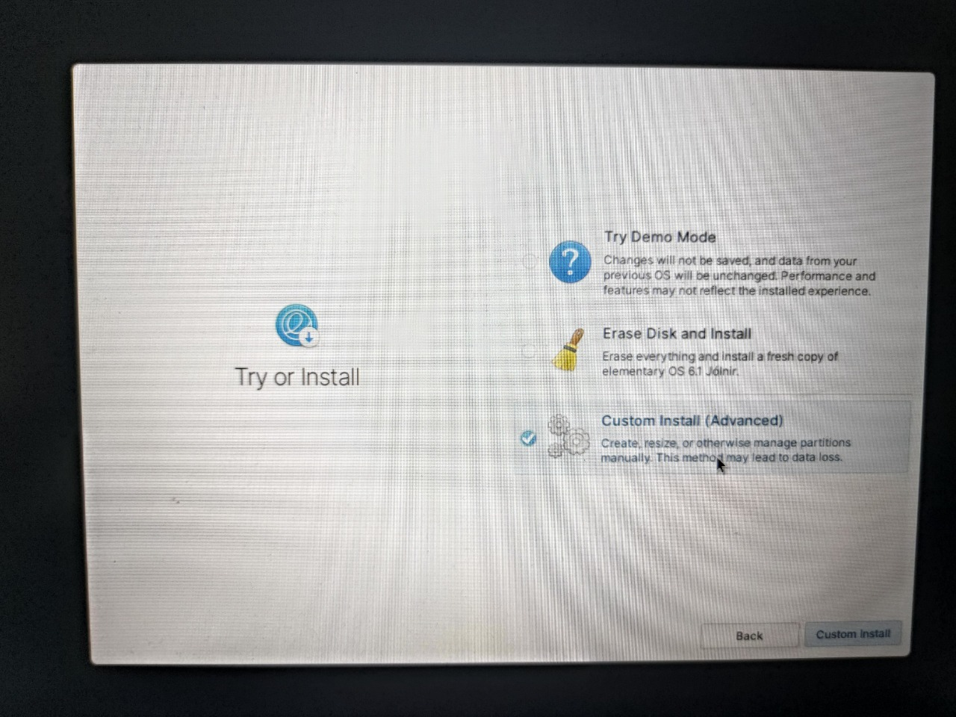
INSTALLATION
Now we have few options to select from.
We can first try the demo version of elementary OS or erase the disk completely and install or select custom install.
We have to select custom install as we have already freed up some space and we can use it here.
Elementary OS

Slide 17
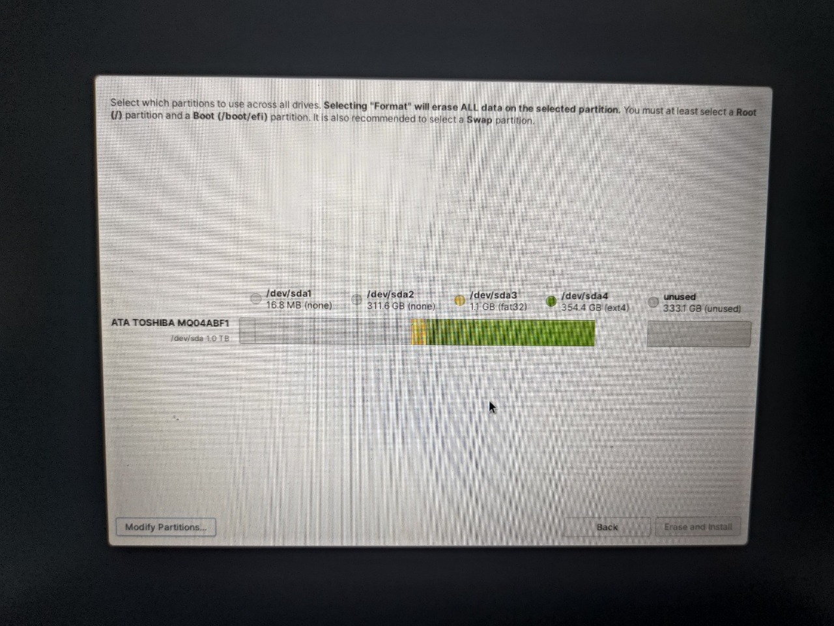
INSTALLATION
After selecting custom install we will arrive here.
Now we have to modify the partitions to create partitions for elementary OS.
To do this we will click the icon “Modify Partitions” at the bottom left.
Elementary OS

Slide 18
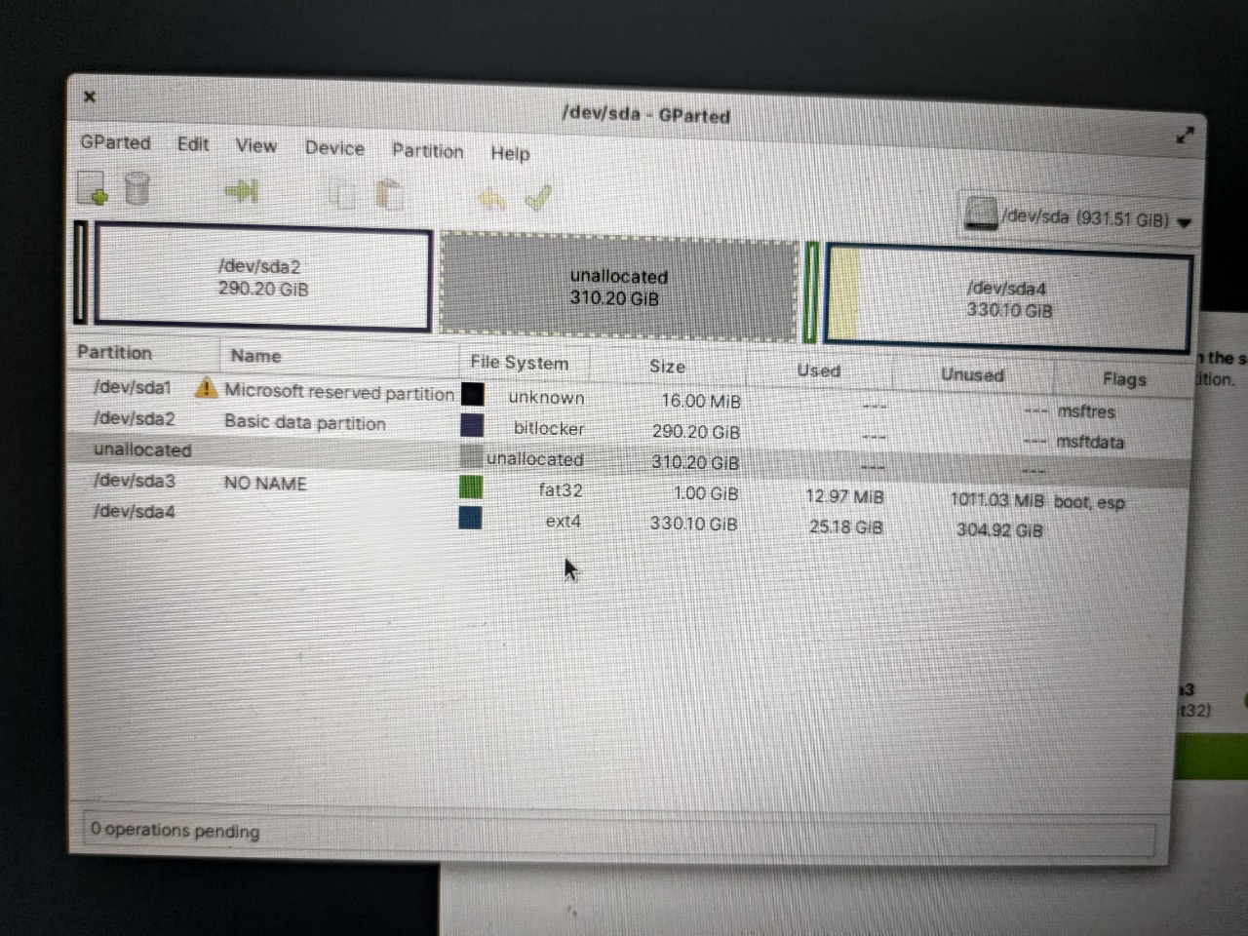
INSTALLATION
This is the GParted window by which we can manage the system partitions.
Here we can see the partition which we created in windows operating system with the name “unallocated.”
Now we have to select the partition option in the header menu and select “Insert”.
Elementary OS

Slide 19
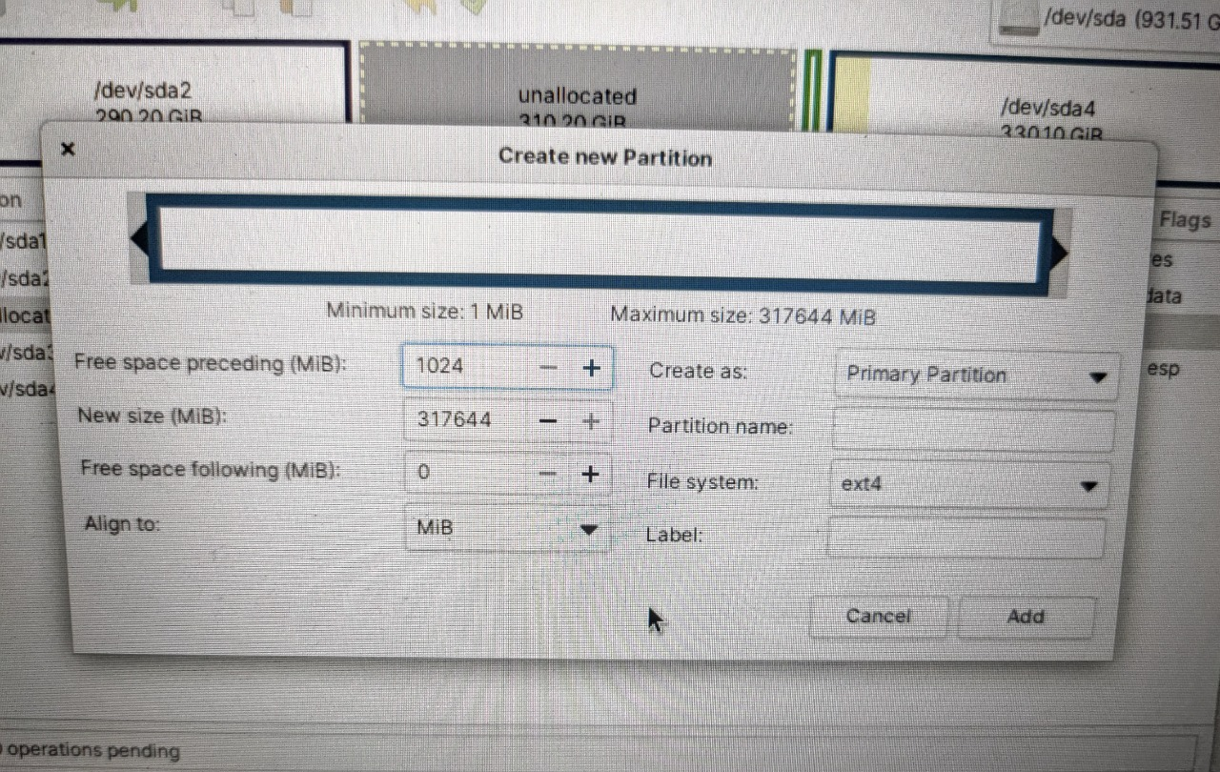
INSTALLATION
Now we will create two partitions.
First partition of size 1GB (in this case) in fat32 format, this partition is used by elementary OS to store the boot files.
Second partition is of 309GB (in this case) in ext4 format, this partition is used by the elementary OS to store root files.
Elementary OS

Slide 20
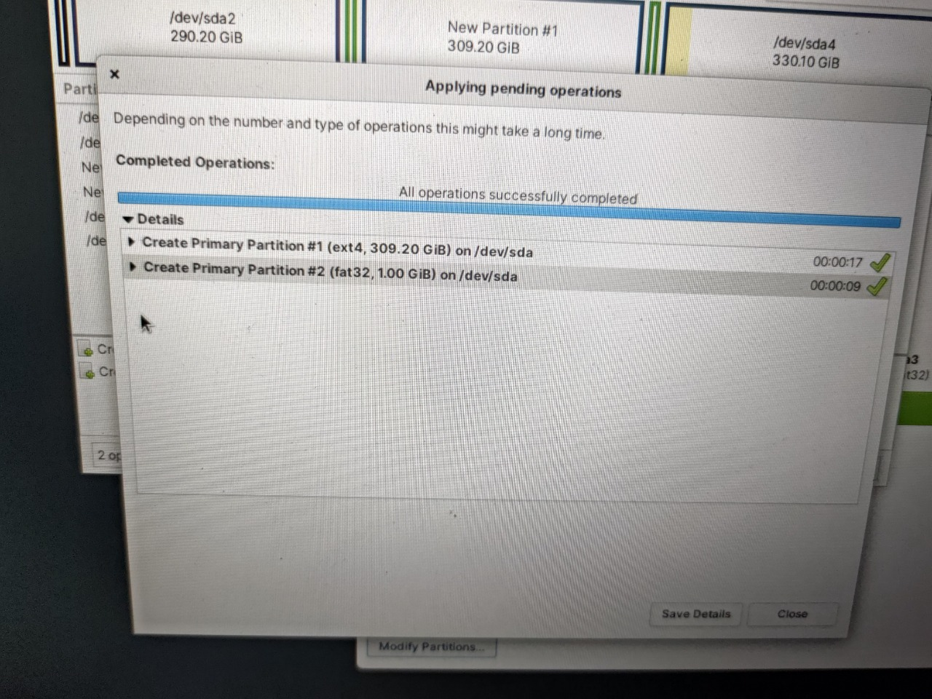
INSTALLATION
After we add the partitions, we have to apply the operations to create them.
After creation, the partitions will be ready to use.
Elementary OS

Slide 21
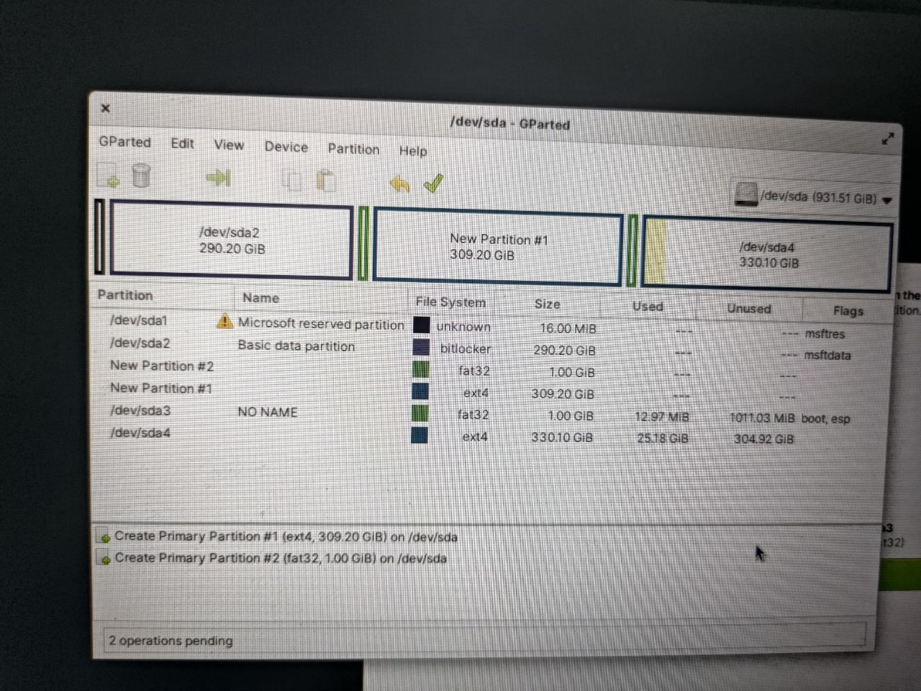
INSTALLATION
Now we can see that two partitions are created.
“New Partition #1” is ext4 format and it is used to store root files.
“New Partition #2” is fat32 format and it is used to store boot files.
Elementary OS

Slide 22
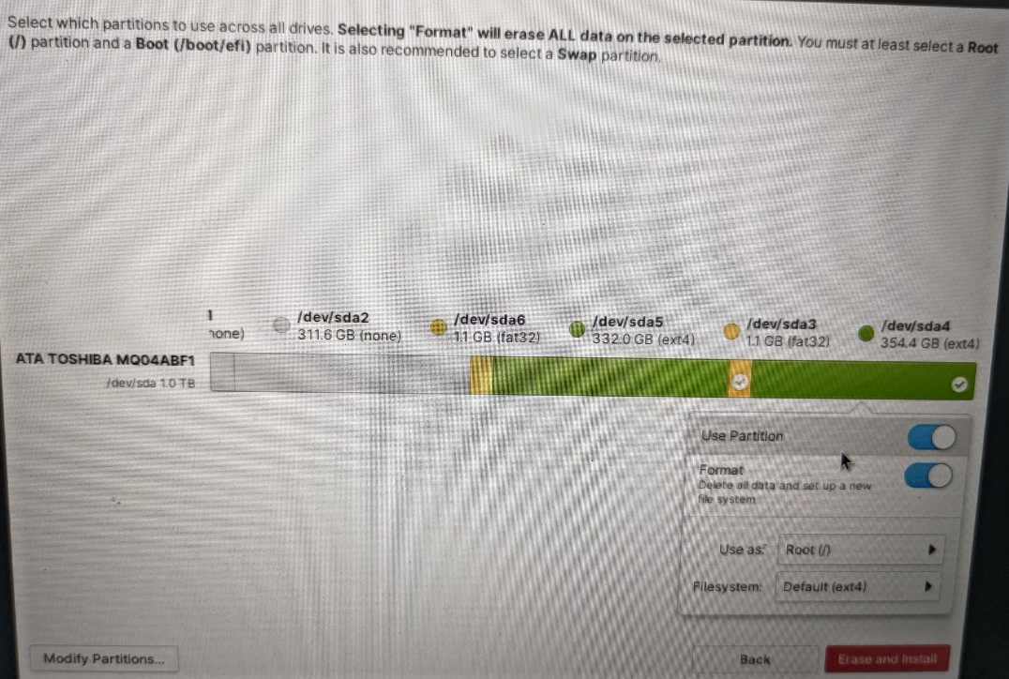
INSTALLATION
Now select the partitions and click erase and install.
After this operations OS will start extracting files.
Elementary OS

Slide 23
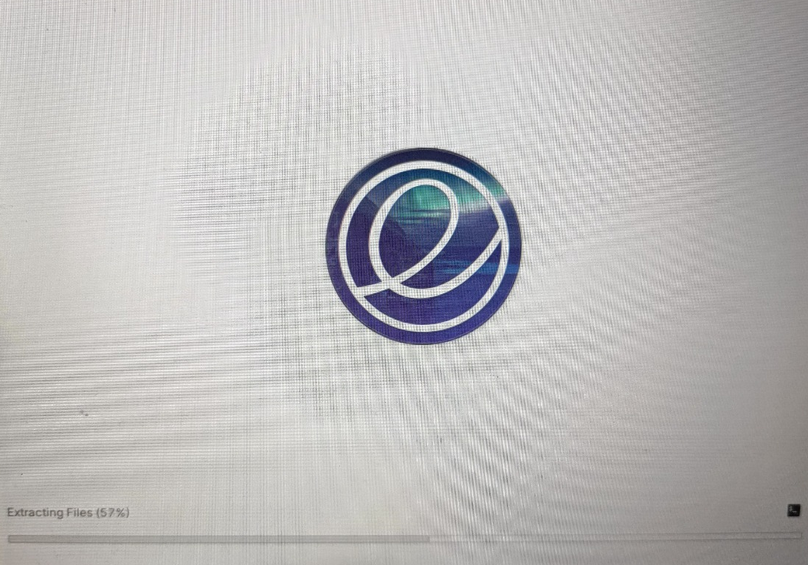
INSTALLATION
After selecting partitions for root and boot the elementary OS will start extracting files from the iso file.
After extraction of files, it will configure the system.
After configuration of system, it will install the OS.
Once installation is done, it will prompt the user to restart or shutdown, if user doesn’t do anything it will automatically restart in 30 seconds.
Elementary OS

Slide 24
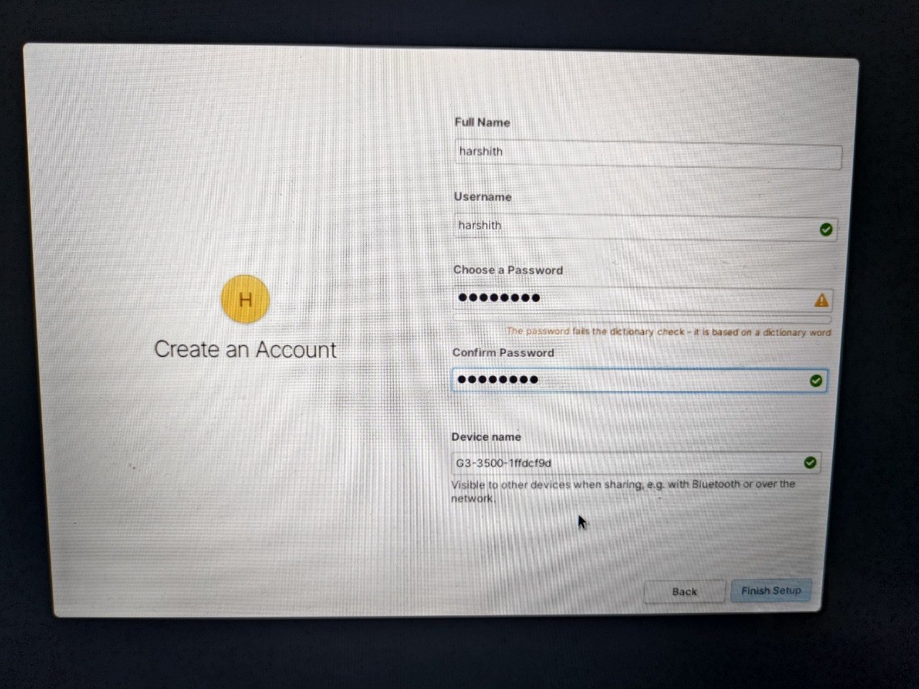
INSTALLATION
Upon restarting, we need to create an account which is basically creating a user for the OS.
This user will get administrator privileges.
Elementary OS

Slide 25
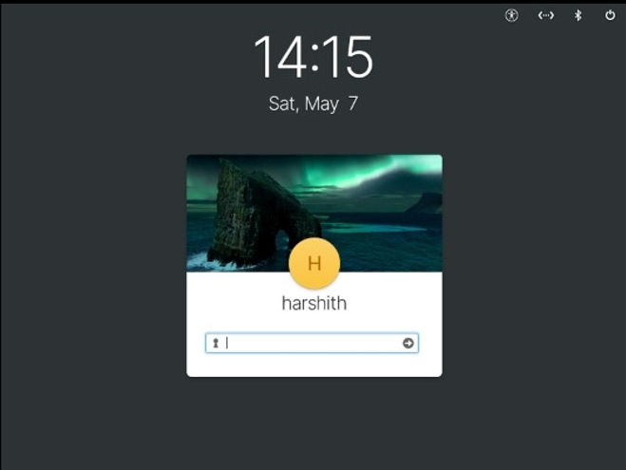
INSTALLATION
Now we have to login using the password we created.
Elementary OS

Slide 26
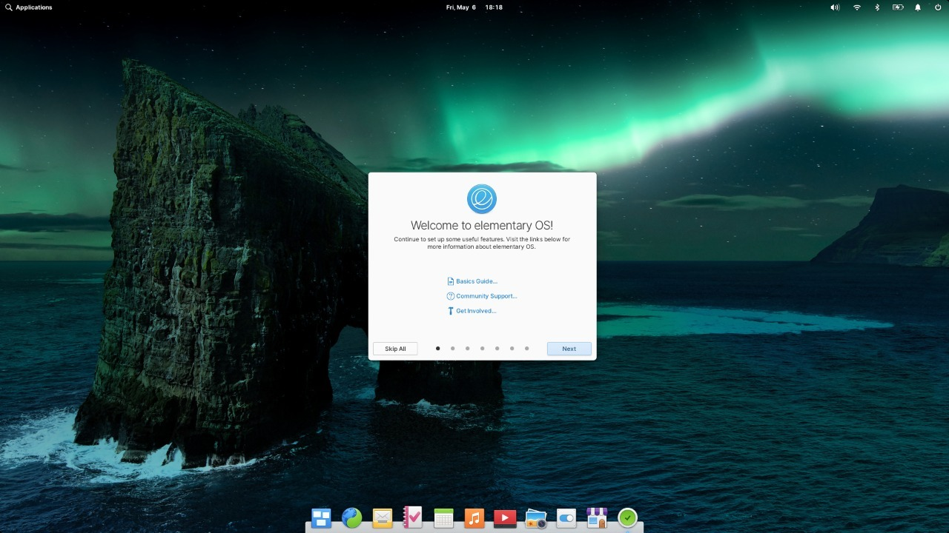
INSTALLATION
After entering the password, we will be redirected to homepage of elementary OS with a welcome screen.
With this we have successfully completed the installation of elementary OS.
Elementary OS

Slide 27
Features
Elementary OS

Slide 28

Why Elementary OS?
Elementary OS Has a Clear Identity and Vision
Elementary OS Is Easy to Learn
The Interface Is Consistent
Easy Web Integration
A Panel That Adapts to Your Wallpaper
Picture-in-Picture Mode
GNOME 2 for GUI and terminal for CLI
Elementary OS

Slide 29
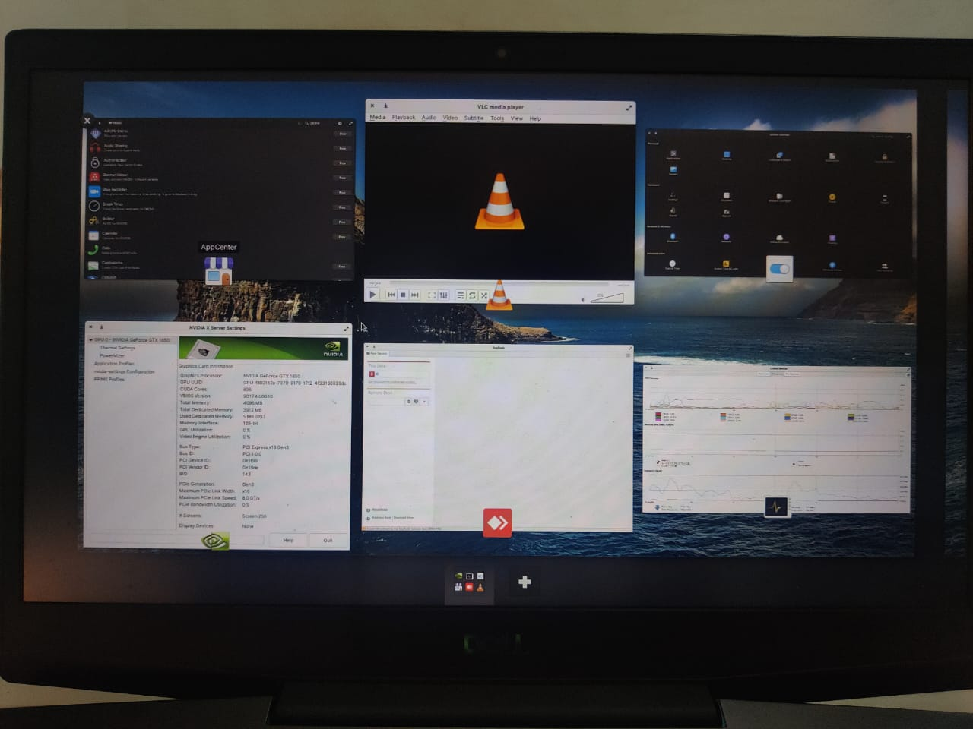
MULTI TASKING
It helps to navigate to the required tab.
Also we can clearly have a look at all the tabs which we are using.
We can create a new desktop and work on it by keeping these applications open in previous desktop.
Elementary OS

Slide 30
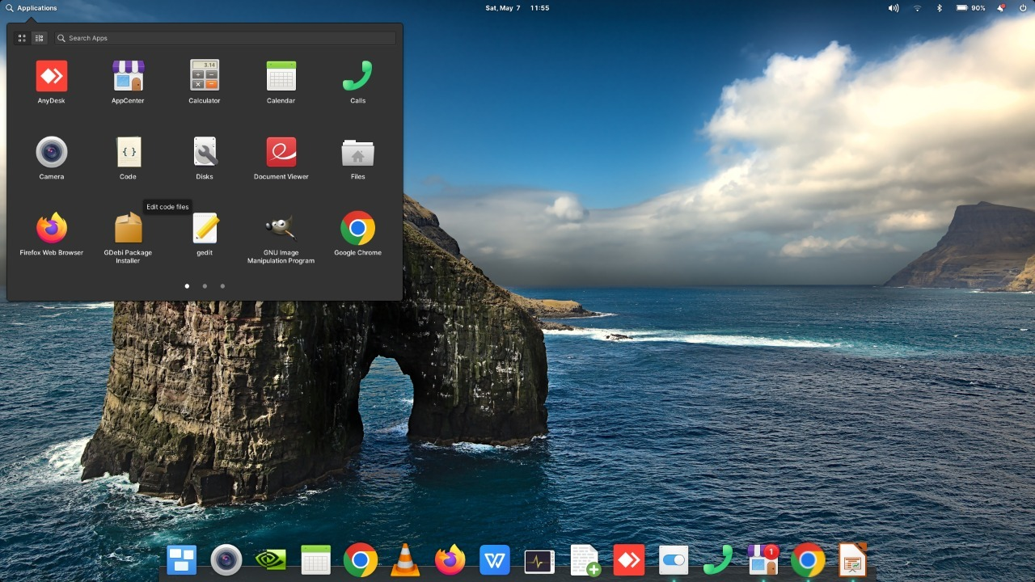
APPLICATION MANAGER
Interactive application manager where we can navigate through applications easily and select it from the list.
We can also add frequently using applications to the dock panel and directly access them.
Elementary OS

Slide 31
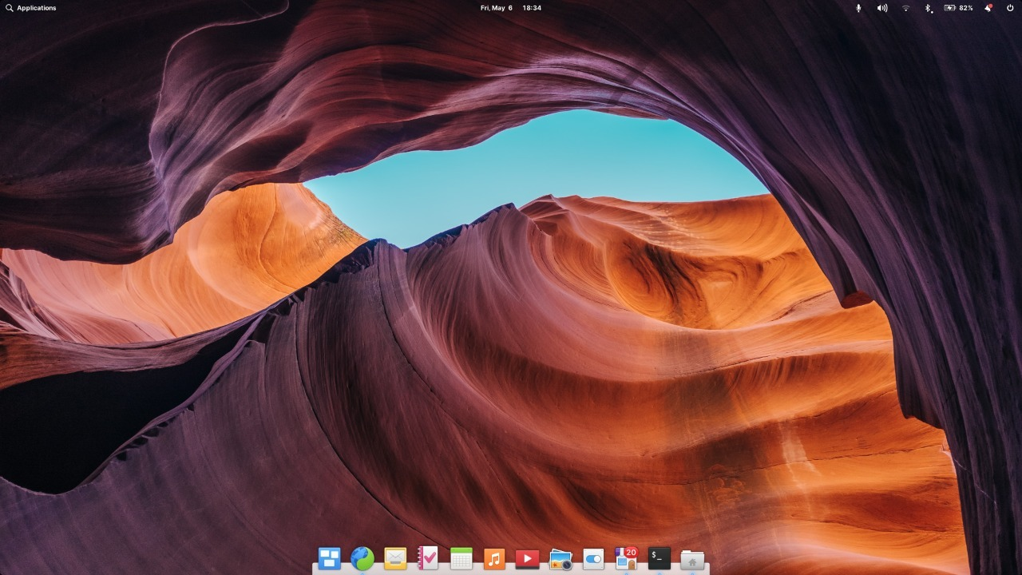
DESKTOP
User interactive and friendly looking desktop which resembles mac OS.
Interactive dock panel and notifications and other icons at the header.
Elementary OS

Slide 32
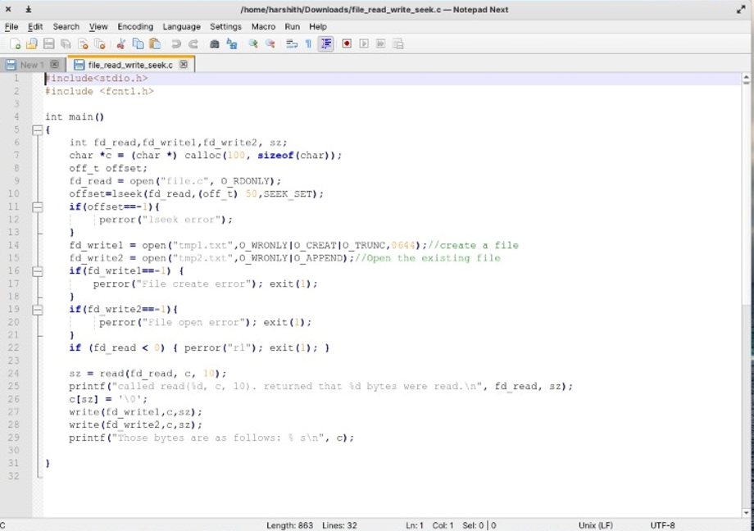
NOTEPAD NEXT
Same as compared to Notepad++ in windows.
Helps us to write and code conveniently by providing appropriate spaces and by highlighting different types of functions.
Elementary OS

Slide 33
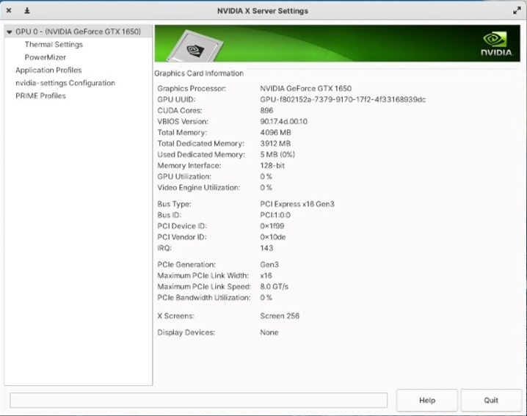
GRAPHIC CARD
NVIDIA graphic card enables users to play games etc.,
This will also system display performance by allocating graphics part to NVIDIA driver.
Elementary OS

Slide 34
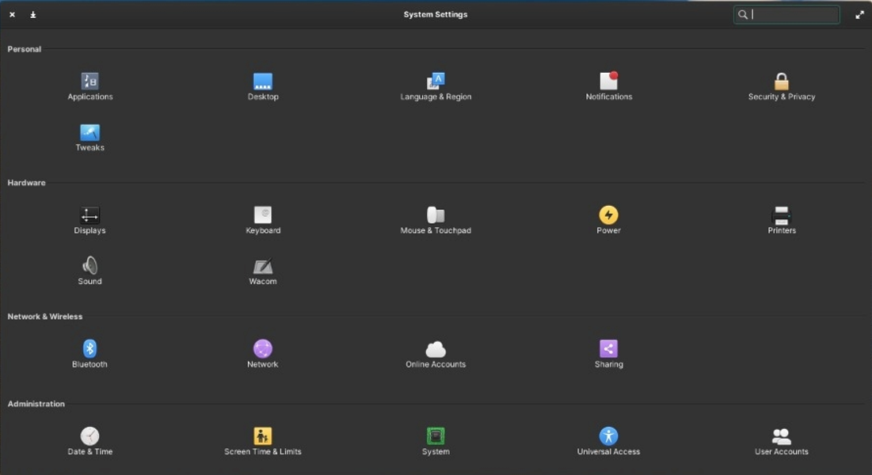
SYSTEM SETTINGS
Interactive system settings and easy go through required settings.
All kinds of settings can be navigated through simple and understandable format menu.
Elementary OS

Slide 35
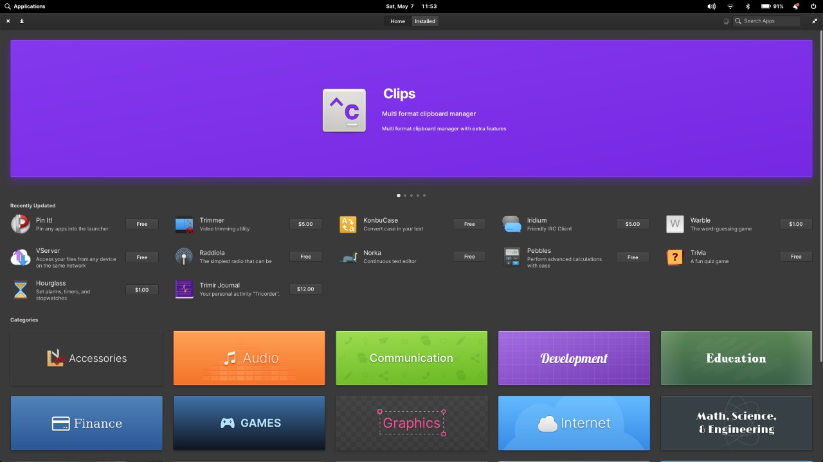
APP CENTER
App store where we can download all kinds of apps required for our uses.
Most of windows OS apps will also be available as non-curated apps, so we can install them.
Elementary OS

Slide 36
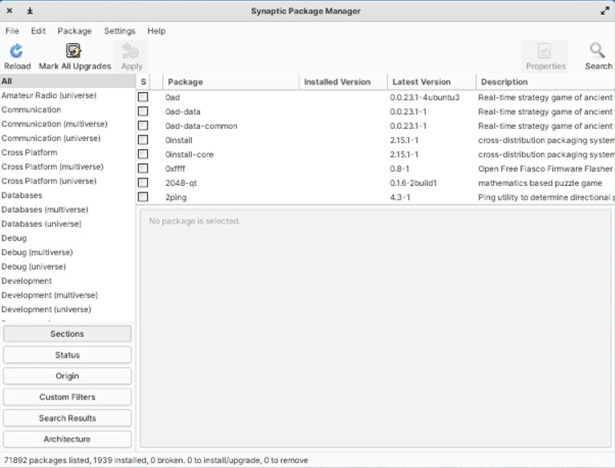
SYNAPTIC PACKAGE MANAGER
Synaptic package manager has all kinds of language packages.
With this we can install required packages in our OS.
Elementary OS

Slide 37
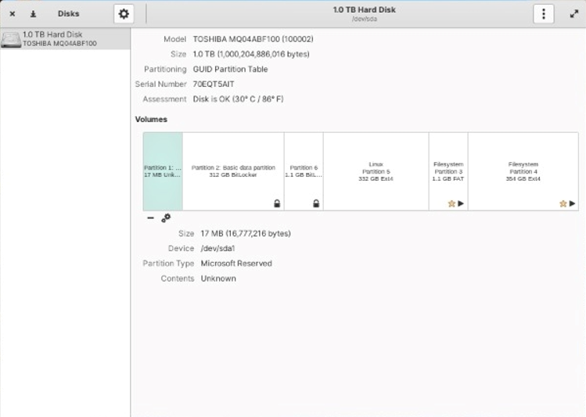
DISKS
Disks application manages all the disks available in the HDD or SSD of system.
We can do operations like format, delete and check permissions and mount with this application.
Elementary OS

Slide 38
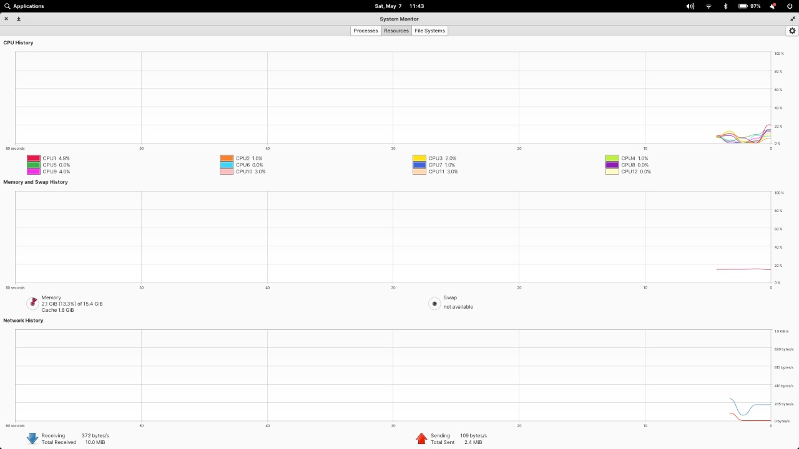
SYSTEM MONITOR
System monitor displays current CPU usage for each core.
It also shows memory usage and internet usage.
We can also view the running processes and file system by clicking those options at the top.
Elementary OS

Slide 39
System calls
Elementary OS

Slide 40
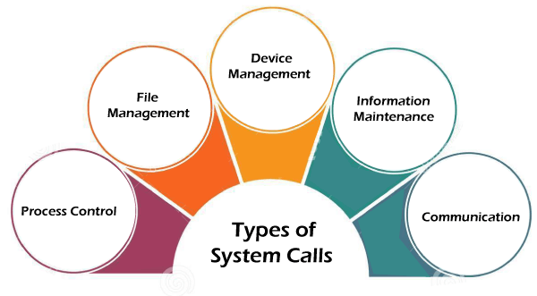
SYSTEM CALLS
A system call is a method for a computer program to request a service from the kernel of the operating system on which it is running. A system call is a method of interacting with the operating system via programs. A system call is a request from computer software to an operating system's kernel.
Services provided by system calls:
Process Creation and Management
Main Memory Management
File Access, Directory and File system Management
Device Handling(I/O)
Protection
Networking
Elementary OS

Slide 41
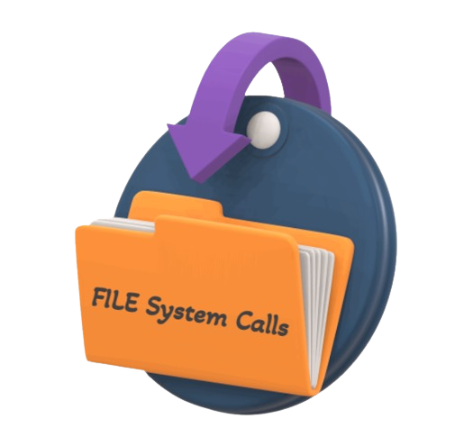
File System calls
Elementary OS

Slide 42
FILE SYSTEM CALLS
In Linux, most of the operations are performed on files. And to handle these files Linux has directories also known as folders which are maintained in a tree-like structure. Linux has 2 types of files:
Regular Files: It is the common file type in Linux. it includes files like – text files, images, binary files, etc. Such files can be created using the touch command. They consist of the majority of files in the Linux system. The regular file contains ASCII or Human Readable text, executable program binaries, program data and much more.
Special Files: Represents a real physical device such as a printer which is used for I/O operations. Device or special files are used for device I/O on Linux systems.
Open()
Close()
Read()
Write()
Lseek()
Mknod()
Some file system calls are:
Close()
Open()
Read()
Write()
Mknod()
Lseek()
Elementary OS

Slide 43

1. Close() - close a file descriptor
Close() closes a file descriptor, so that it no longer refers to any file and may be reused. Any record locks held on the file it was associated with, and owned by the process, are removed (regardless of the file descriptor that was used to obtain the lock).
Close() returns zero on success. On error, -1 is returned, and errno is set to indicate error.
Syntax:
int close(int fd);

Slide 44
2. Open() –Open a file
Syntax:
#include <fcntl.h>
int open(const char *pathname, int flags);
int open(const char *pathname, int flags, mode_t mode);
Description:
Return:
The open() system call opens the file specified by pathname. If the specified file does not exist, it may optionally be created by open().
The return value of open() is a file descriptor, a small, nonnegative integer that is an index to an entry in the process's table of open file descriptors
3. Read() -Read a file
Syntax:
#include <unistd.h>
ssize_t read(int fd, void *buf, size_t count);
Description:
Read() attempts to read up to count bytes from file descriptor fd into the buffer starting at buf.
Return:
On success, the number of bytes read is returned. On error, -1 is returned, and errno is set to indicate the error.

Slide 45
4. Write() - Write to a file descriptor
Syntax:
#include <unistd.h>
ssize_t write(int fd, const void *buf, size_t count);
Description:
write() writes up to count bytes from the buffer starting at buf to the file referred to by the file descriptor fd.
Return:
On success, the number of bytes written is returned. On error, -1 is returned, and errno is set to indicate the error.
5. Mknod - Create a special or ordinary file
Syntax:
#include <sys/stat.h>
int mknod(const char *pathname, mode_t mode, dev_t dev);
Description:
The system call mknod() creates a filesystem node (file, device special file, or named pipe) named pathname, with attributes specified by mode and dev.
Return:
mknod() and mknodat() return zero on success. On error, -1 is returned and errno is set to indicate the error.

Slide 46
6. Lseek()- reposition read/write file offset
Syntax:
#include <sys/type.h>
#include <unistd.h>
off_t lseek(int fd, off_t offset, int ref);
Description:
To position a pointer that point to the current position in an absolute or relative way can be done by calling the lseek function.
Return:
On successful returns resulting offset location as measured in bytes a value of (off-t)-1 is returned and errno is set to indicate the error

Slide 47
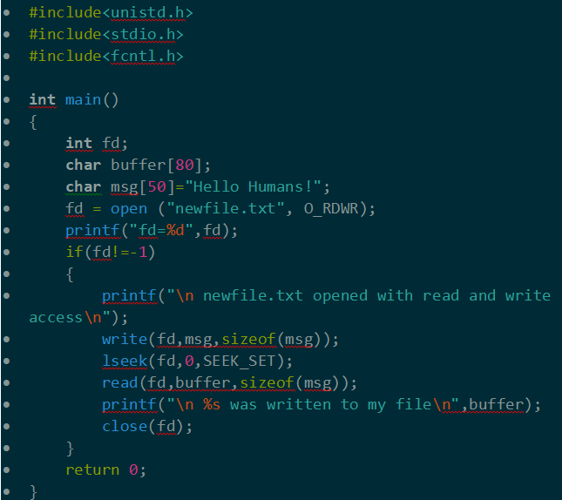

Slide 48
Directory System calls
Elementary OS

Slide 49
1. Mkdir()
Syntax:
int mkdir(const char *pathname,mode_t mode);
Description:
mkdir() system call creates a directory named pathname mkdirat() is identical to mkdir();the only difference is that the directory is given as an open file descriptor.
Return:
mkdir() and mkdirat() returns zero on success or -1 if an error occured and errno is set approximately.
2. Chdir()
Syntax:
int chdir(const char *path);
int fchdir(int fd);
Description:
chdir() changes the current working directory of the calling process to the directory specified in path.
fchdir() is identical to chdir(); the only difference is that the directory is given as an open file descriptor.
Return:
chdir() and fchdir() returns zero on success or -1 if an error occured and errno is set approximately

Slide 50
3. Chroot()
Syntax:
int chroot(const char *path);
int fchroot(int flides);
Description:
chroot()and fchroot() functions cause a directory to become the root directory the starting point for path searches for pathnames. The users working directory is unaffected by the calls.
Return:
upon successful completion 0 is returned otherwise -1 is returned the root directory remains unchanged and err is set to indicate the error
4. Readdir()
Syntax:
DIR *DirectoryPointer;
Struct direct *readdir(Directory Pointer);
Description:
The readdir() System Call function is used to read into a directory
Return:
upon successful completion returns a pointer to an object of type struct duent else a null value is returned and the errno variable is set.When the end of the directory is encountered,a null value is returned and errno variable is not affected.

Slide 51
5. Open dir()
Syntax:
DIR *opendir(const char *name);
DIR *fdopendir(int fd);
Description:
Opendir() function call opens a directory stream corresponding to the directory name and returns a pointer to the directory system fdopendir() is identical to opendir() but returns a directory referred to by the open file desreptor fd.
Return:
Returns a pointer to the directory stream. On error NULL is returned and errno is set appropriately
6. Rewinddir()
Syntax:
Void rewinddir(DIR *dirp);
Description:
The rewinddir() function resets the position of the directory stream to which dir refers to the begining of the directory.
Return:
The rewindir() function does not return a value.

Slide 52
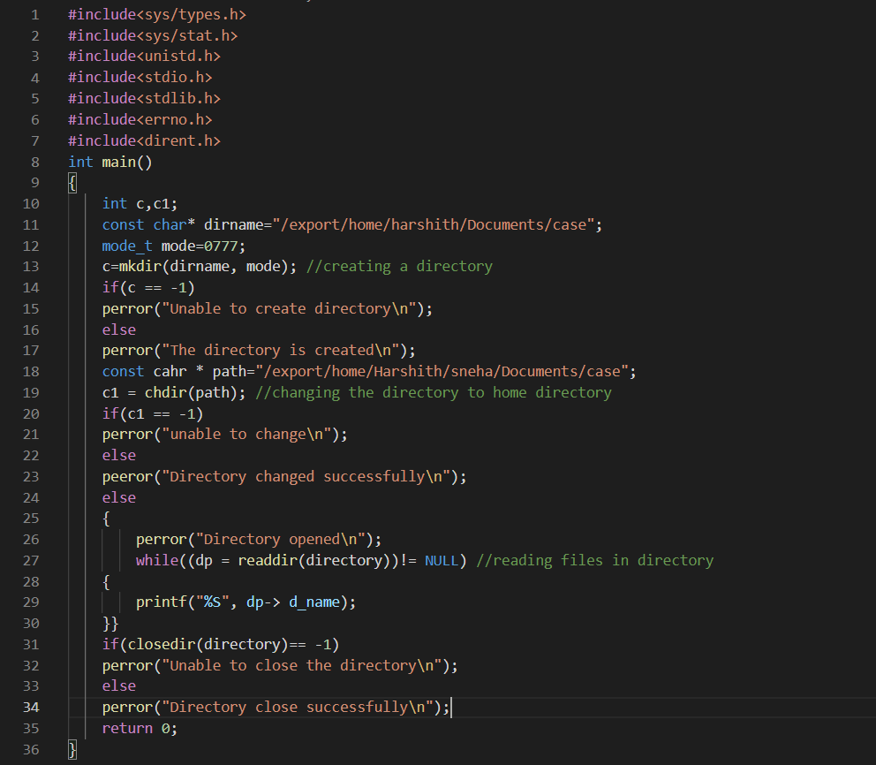

Slide 53
PROCESS SYSTEM CALLS
Elementary OS

Slide 54
Wait()
Parent waits for a child (system call)
• blocks until a child terminates
#include <sys/types.h>
#include <sys/wait.h>
pid t wait (int *status);
Parent waits for a specific child to terminate
#include <sys/types.h>
#include <sys/wait.h>
pid t waitpid (pid t pid, int *status, int options);
Returns:
• Returns pid of the child process
• Returns -1 if no children exists (already exited)
Fork()
• Child process inherits state from parent process
• Child have separate copies of that state Parent and
child share access to any open files.
Syntax:
Pid=fork()
If(pid!=0)
{
/* In parent */
..
}else {
/* In child */
..}
Returns:
Parent : fork() returns the child process ID
Child():fork returns a 0

Slide 55
Execlp()
Fork copies the state of the parent process Child continues running the parent program with a copy of the process memory and registers.
Need a way to invoke a new program In the context of the newly-created child process
Syntax
#include <unistd.h>
int execlp(const char *file, const char *arg, ...);

Slide 56
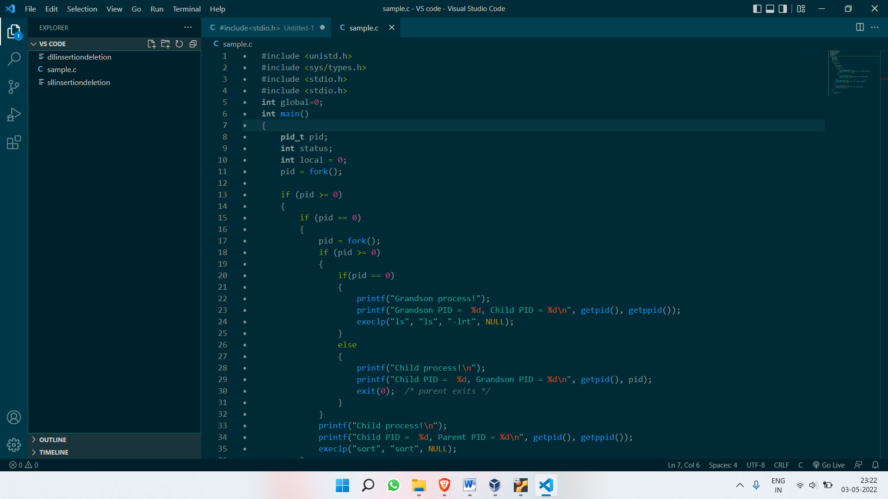
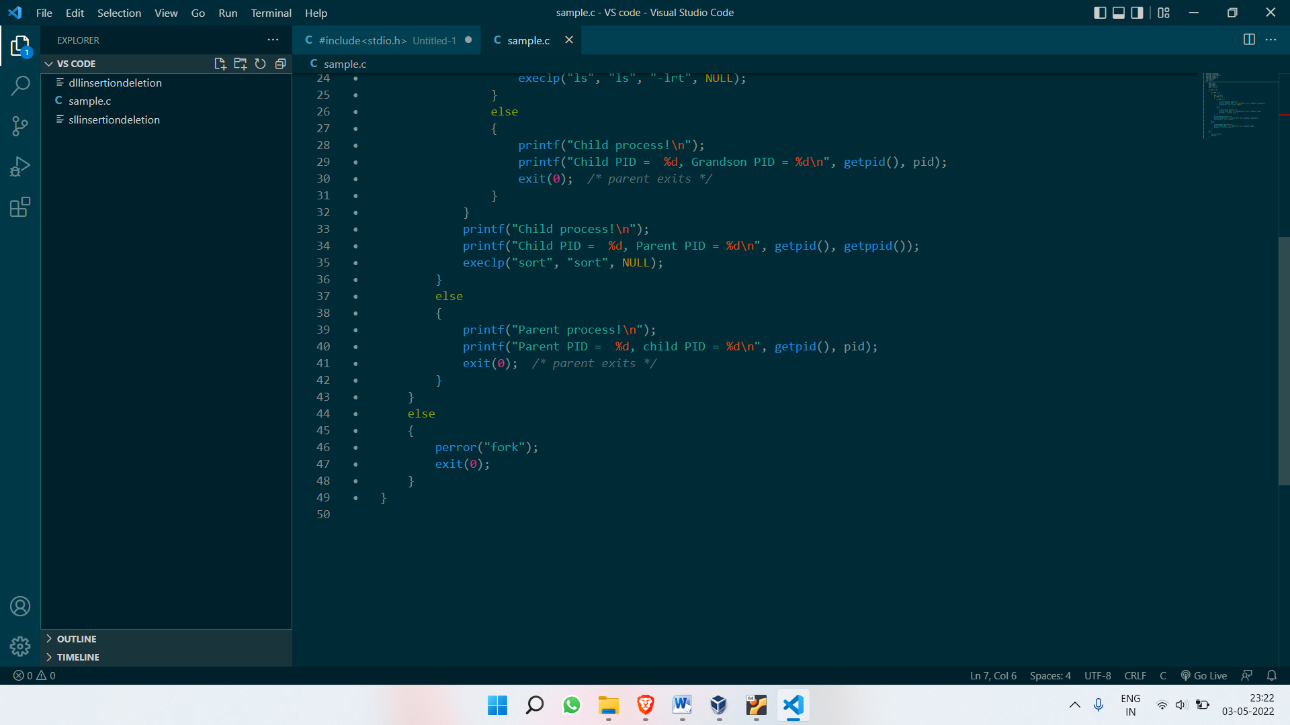

Slide 57
Scheduling algorithms
Elementary OS

Slide 58
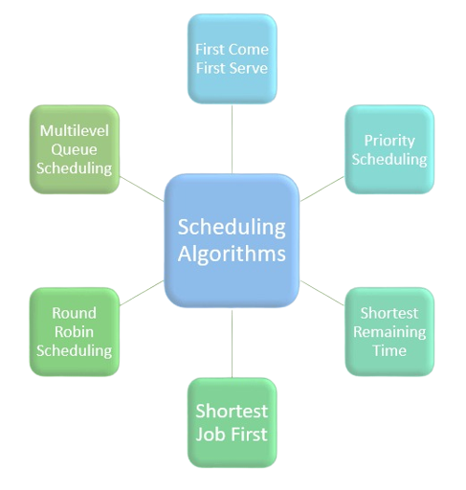

Slide 59
A Scheduling Algorithm is the algorithm which tells us how much CPU time we can allocate to the processes.
These scheduling algorithms are either preemptive or non-preemptive.
Preemptive Scheduling Algorithms are those which are based on the priority of the processes. By preference, when a high priority process enters, it preempts a low priority process in between and executes the high priority process first.
Non-preemptive Scheduling Algorithms are those who can’t be preempted in between, i.e. we can not take control of CPU in between until the current process completes its execution.
Six types of scheduling algorithms:
Priority Scheduling
Shortest-Job-Next (SJN) Scheduling
First-Come, First-Served (FCFS) Scheduling
Shortest Remaining Time
Round Robin(RR) Scheduling
Multiple-Level Queues Scheduling

Slide 60
References:
https://elementary.io/docs/installation#installation
https://rufus.ie/en/
http://linasm.sourceforge.net/docs/syscalls/filesystem.php
https://www.google.com/

Slide 61


